Slide 1
Year 6 residential information

Slide 2
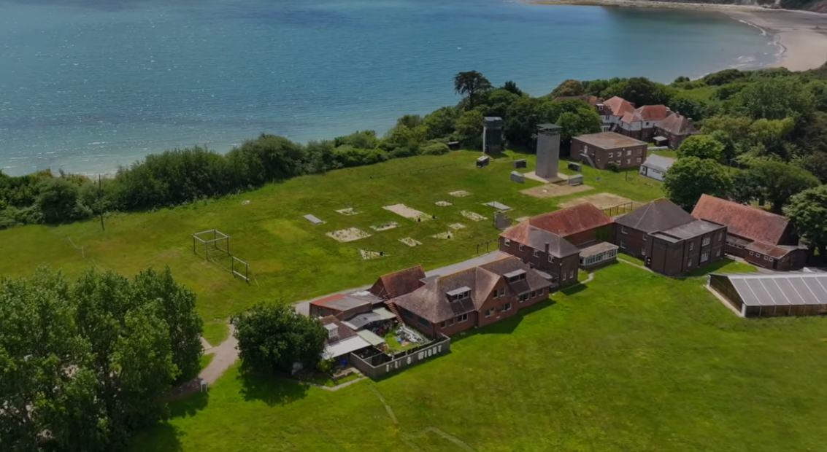
The site

Slide 3
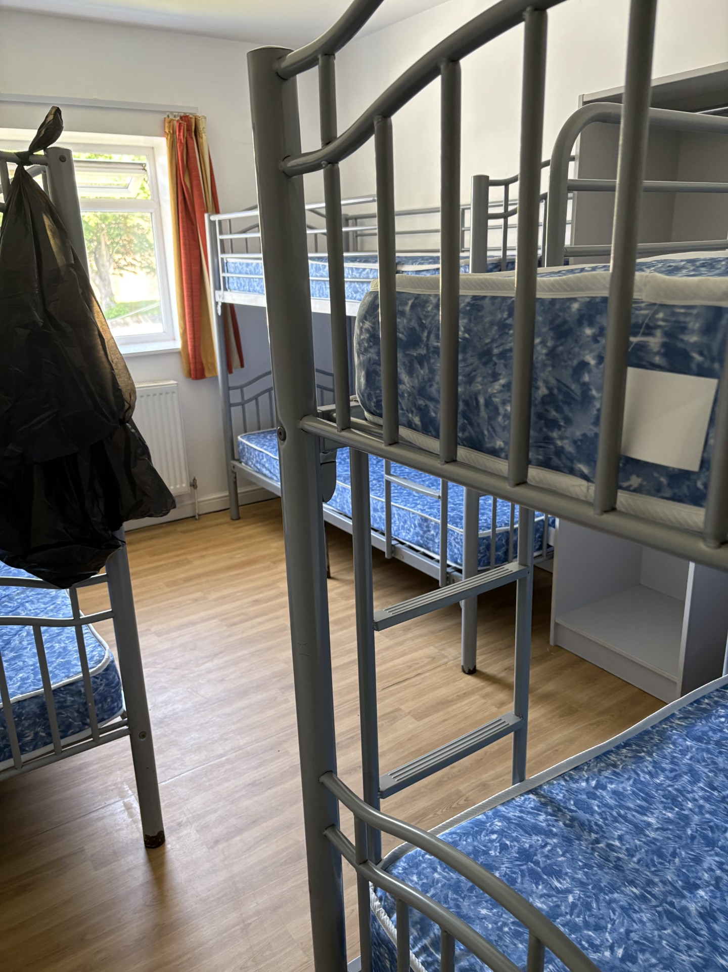
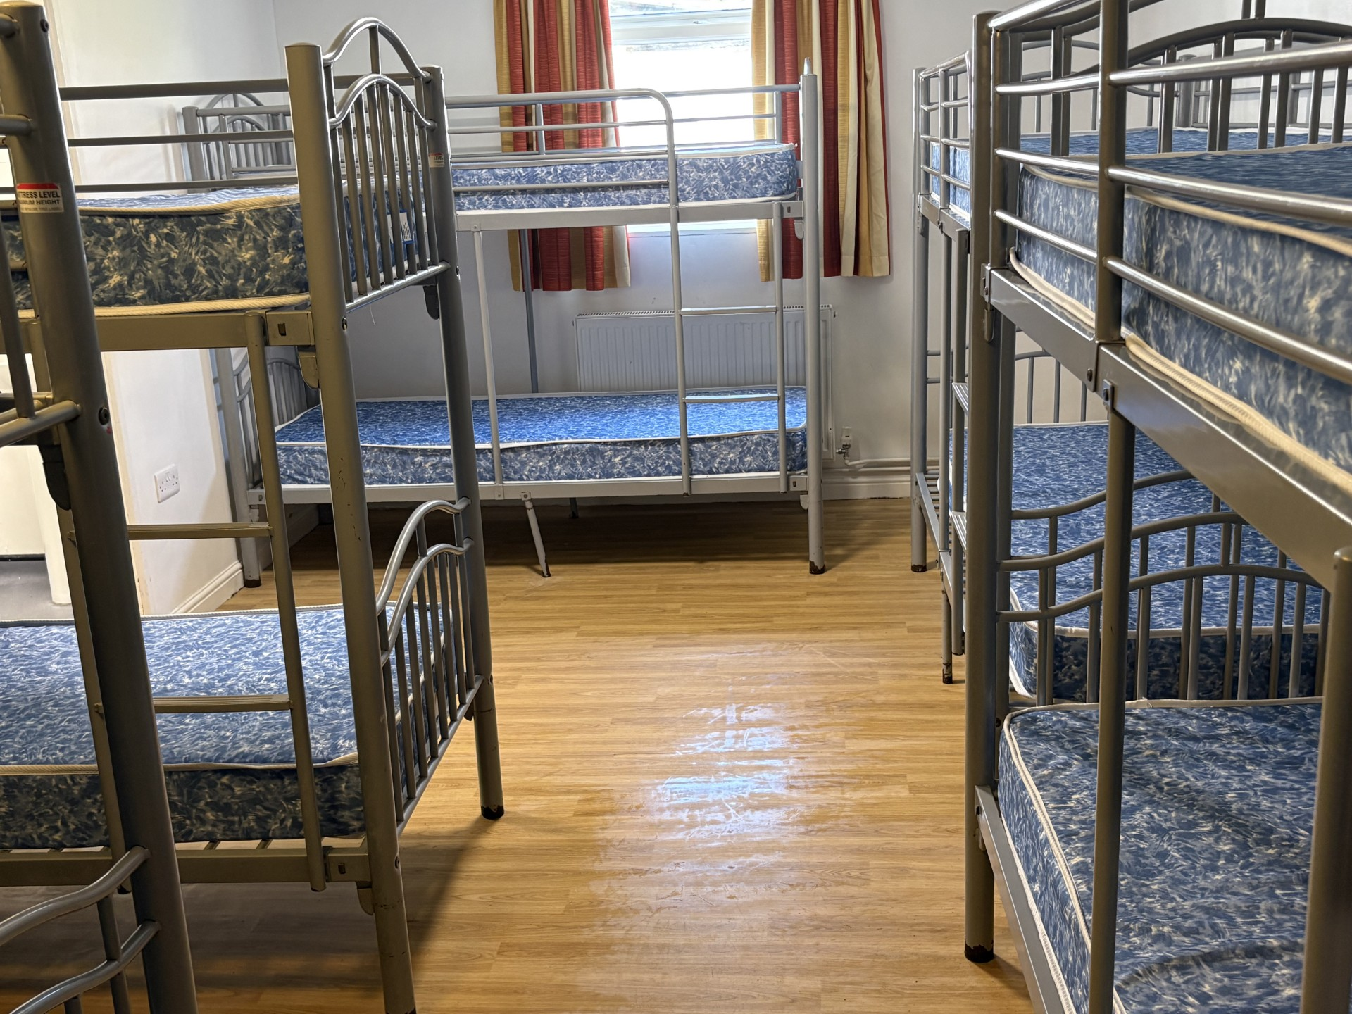
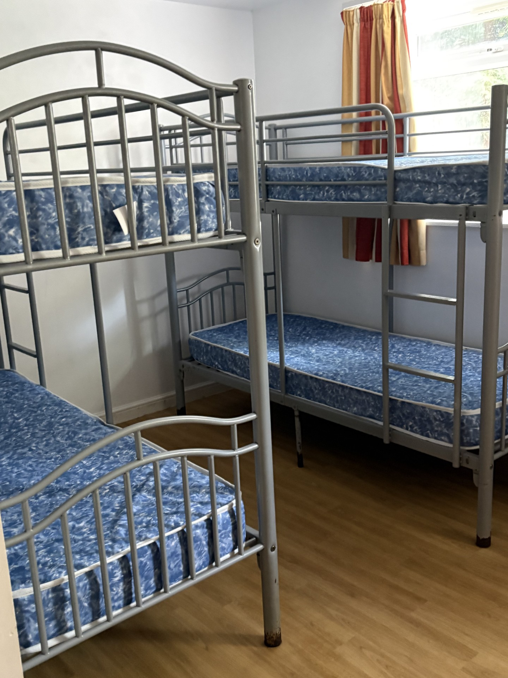
The bedrooms

Slide 4
Staff going on the trip:
Mrs Steel
Mrs Denslow
Mrs Simmonds
Mrs Mitchell
Mrs Hall

Slide 5
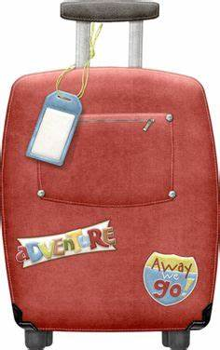
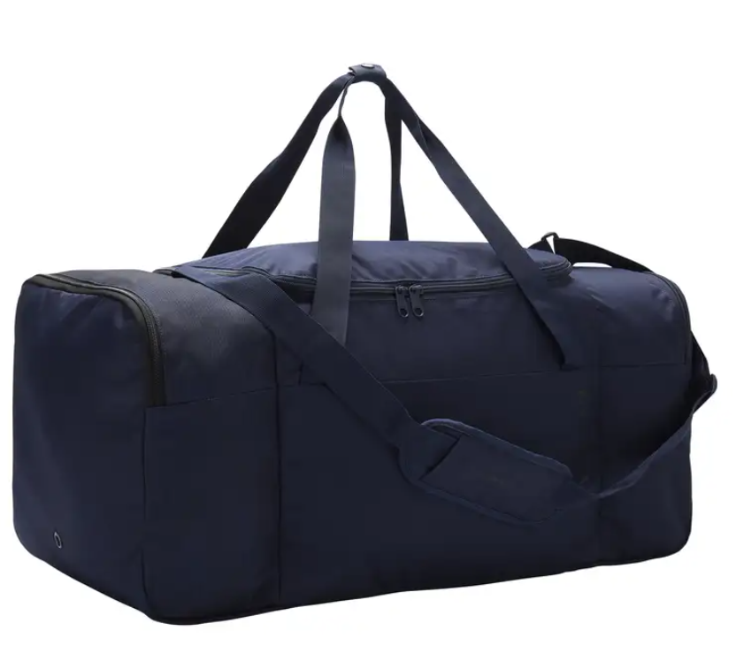
Year 6 Residential to Manor Adventure, Bembridge, Isle Of Wight.
Monday 12th October
Arrive at school normal time or around
9am after the school rush if this is easier.
Please bring the children and their
suitcases (named) to reception area.
Please bear in mind that the children
will be responsible for moving their
bags from the coach to the dorms. So
consider the appropriate size of luggage.

Slide 6

Please could we ask for all medicines named, labelled with the dosage and handed in to Mrs Simmonds and Mrs Mitchell when you drop your child off on Monday 12th.
Please ensure your child takes any travel sickness tablets before they arrive at school.
A green form needs filling in
when you arrive for
medicines.

Slide 7


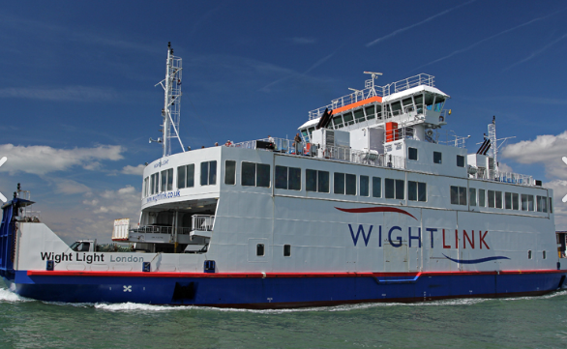
Travel day
We will leave Burton at approx 10.50am and will travel by coach to Lymington.
The ferry crossing is at 12.00pm and due to arrive in Yarmouth at 12.40.
The coach will then take us to Bembridge to arrive at Manor for approx 1.30pm.
We will eat lunch on the ferry so please ensure your your child has a packed lunch in a disposable bag.
You do not want a mouldy lunch box arriving home
On Friday…there will be enough smelly clothes returning home!

Slide 8
Nightline
The children could get very wet and muddy for this activity so please remember to pack a spare pair of shoes or wellies. Old clothes are also needed and packed in a separate plastic bag and label it with ‘Nightline’.

Slide 9

Please pack a named refillable water bottle (shatterproof)
There will be other schools on site the same time as us so really important everything is named.
Spending money:
There is a shop on site. They are allowed to buy fizzy drinks, sweets and souvenirs.
Please provide a named purse in case dropped at the site. We suggest up to £20 in coins. You can spend less but sweets and ice cream and a souvenir will cost more than a normal shop! There are cheap pencils and pens etc.

Slide 10
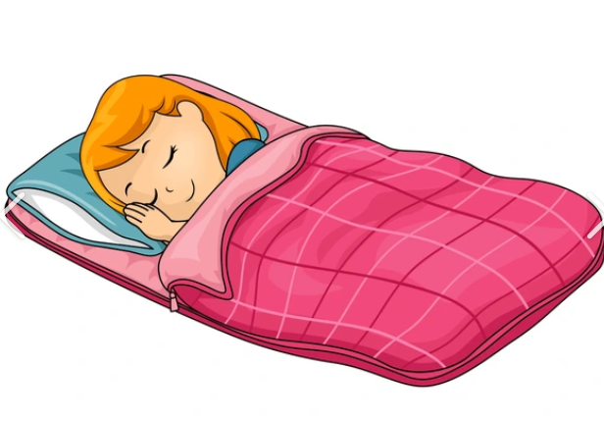
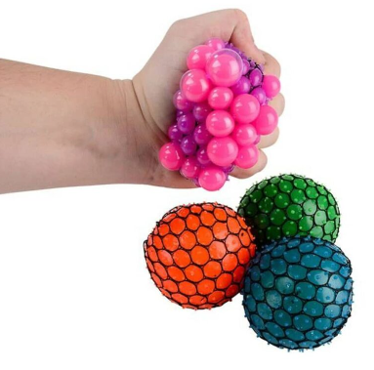
What to pack
Freshly laundered sleeping bag and pillow with pillowcase
Teddy/cuddle companion
Warm hoodie/PJs
Uno/dobble/card games/book
No electronics please
Please do not allow them to these fidget balls as we have had them explode in the coach before and made quite a mess.

Slide 11

Please pack black sacks for dirty clothes to be put in.

Slide 12

Friday 16th October
Departing Manor at 12.40 to catch the 2.05pm ferry so we anticipate arriving back at Burton around 3.15pm!
Please check your email as this is how we will keep you updated.

Slide 13

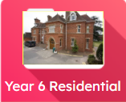
Throughout the week we will endeavour to take photos and videos of the fun we are having, to share with you.
Please make sure you can access J2e.
Ask your child to teach you. Look for Manor IOW tile. (We cannot put these on the school website as some children do not have permission for photos.)
We will upload photos as and when we can. We ask you kindly to not download these on to a device as the photo is likely to have other children in them.
We will also communicate through Marvellous Me app?

