Slide 1

Welcome!

Slide 2

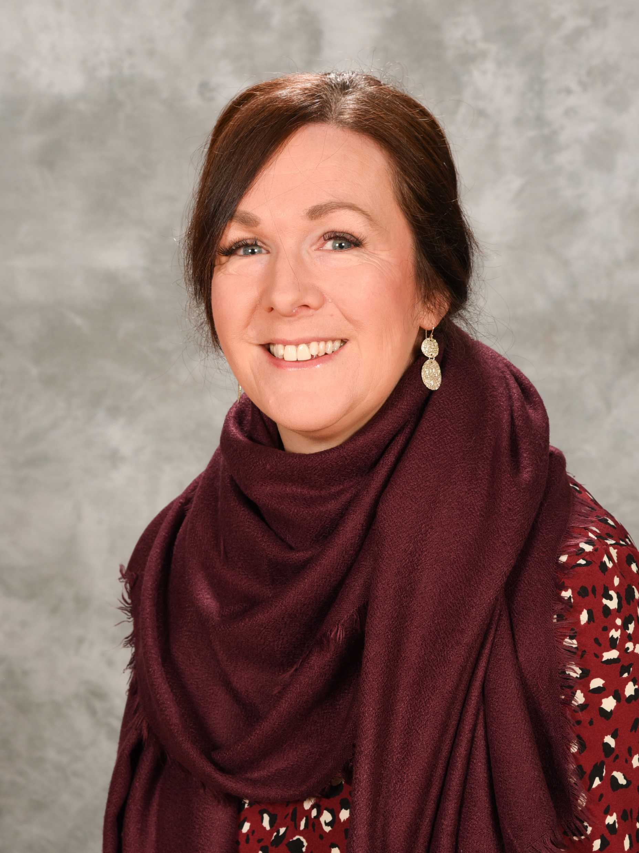
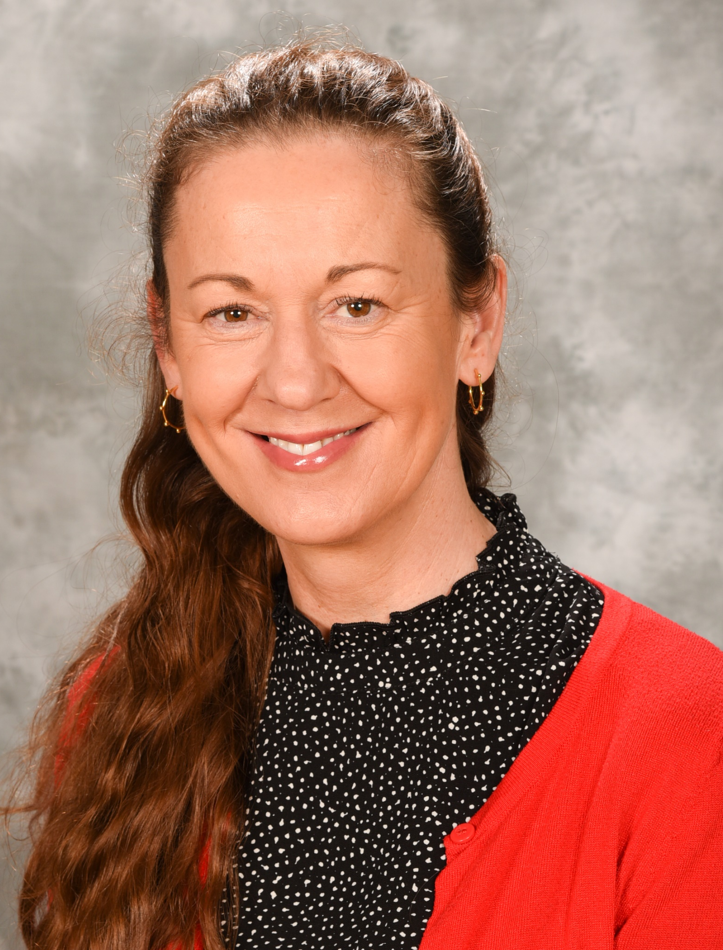
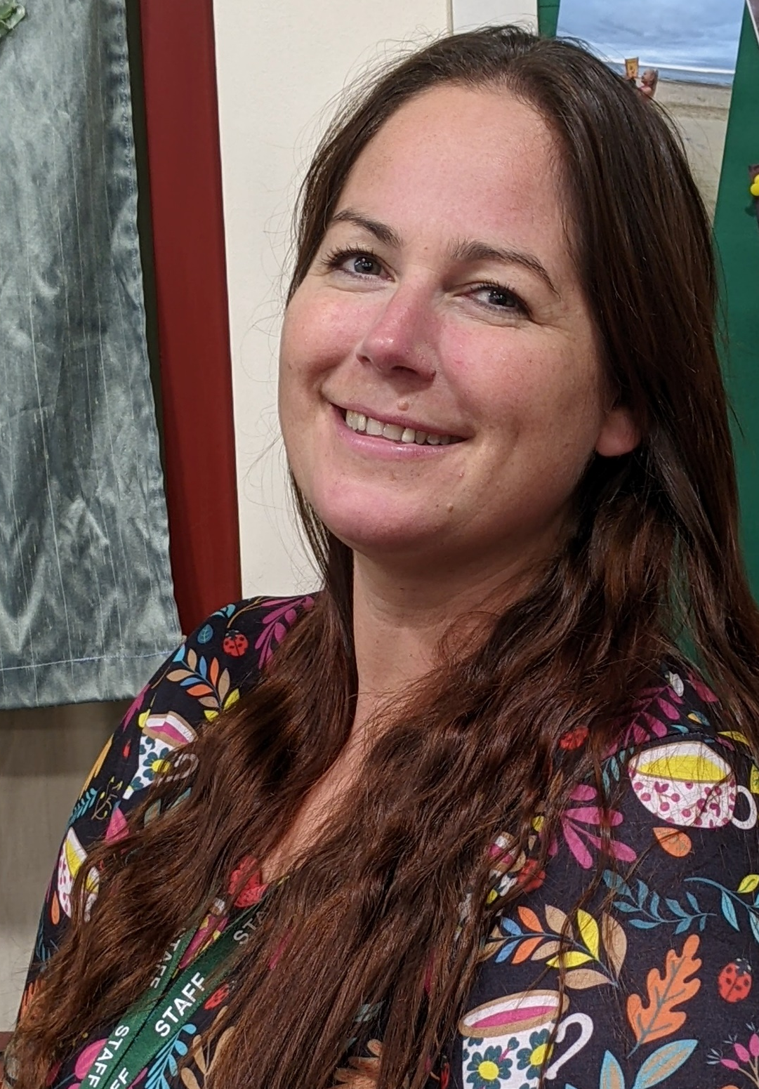
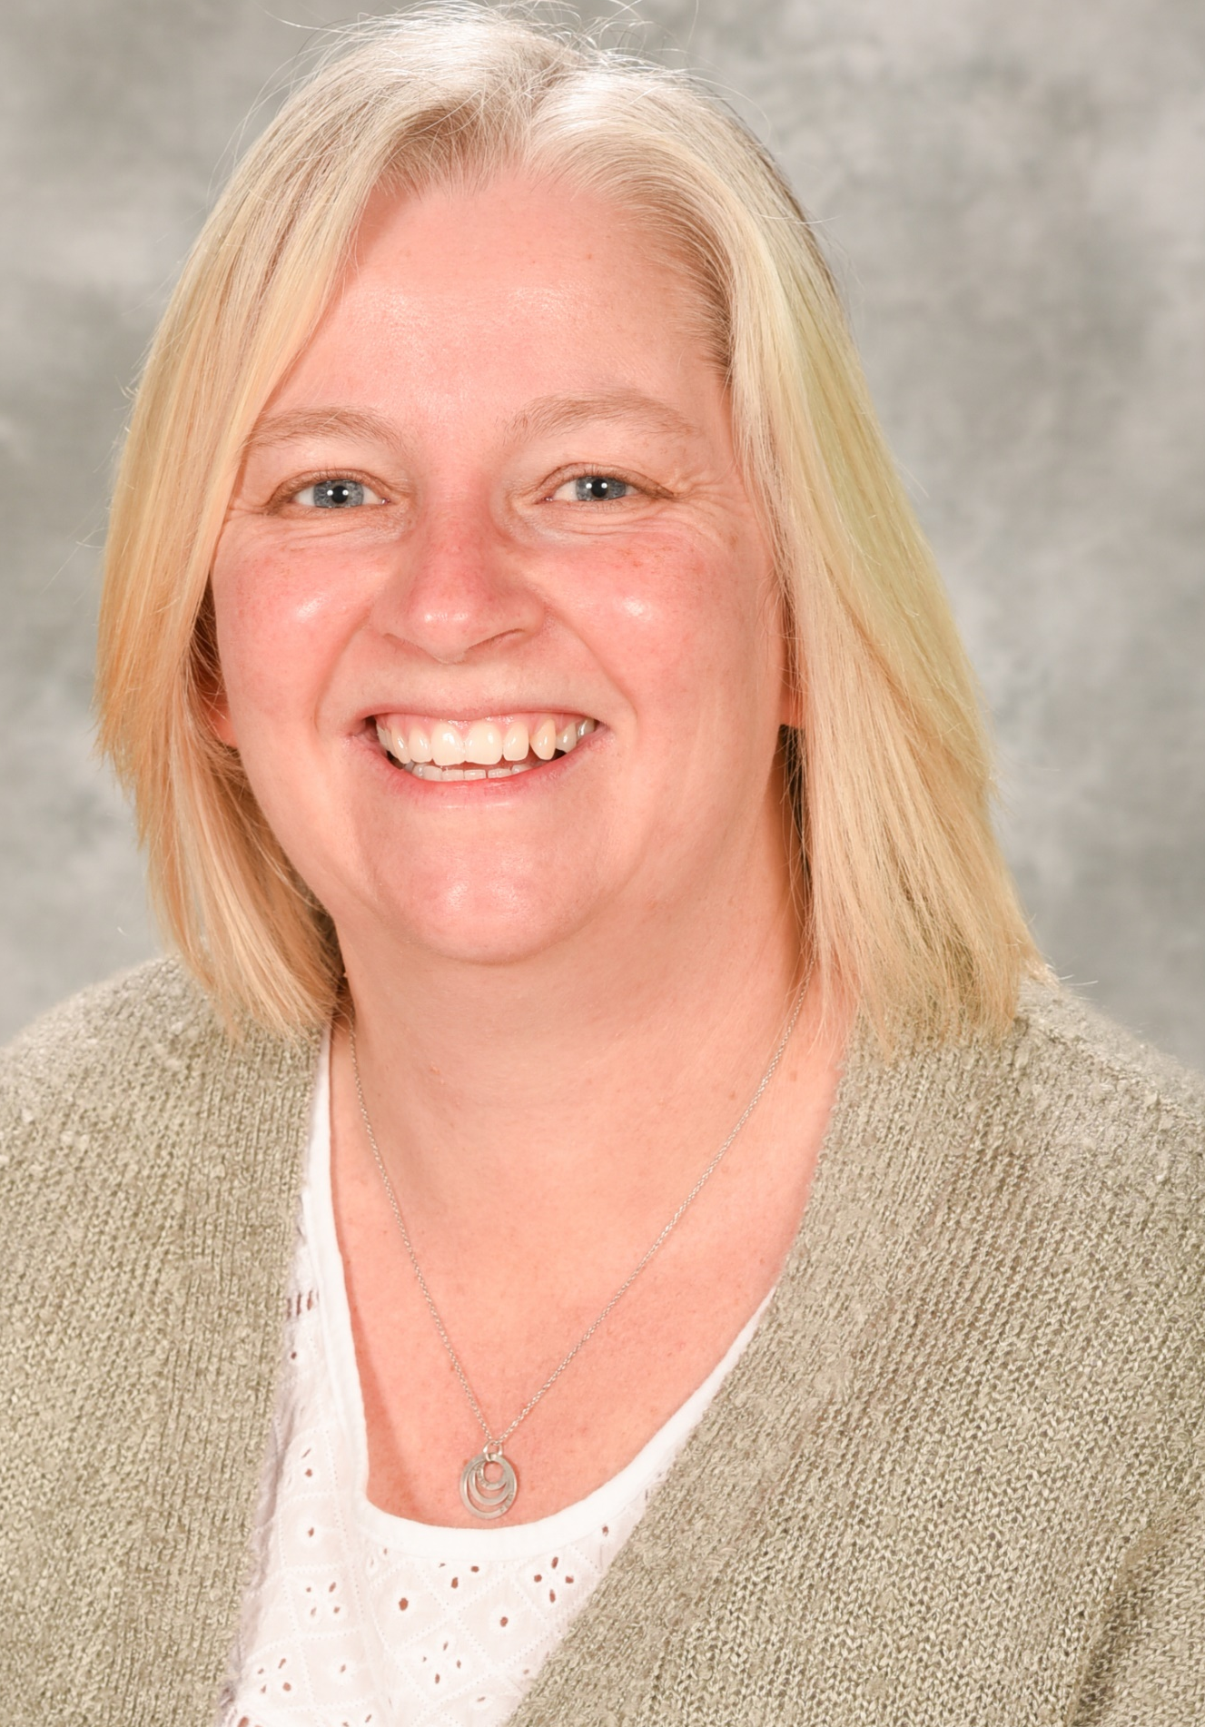

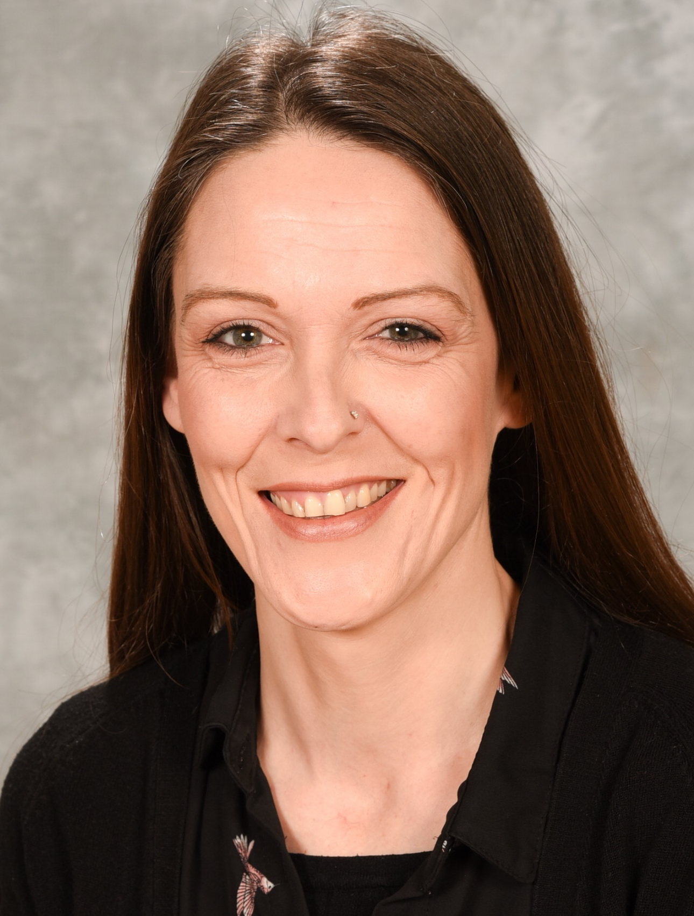
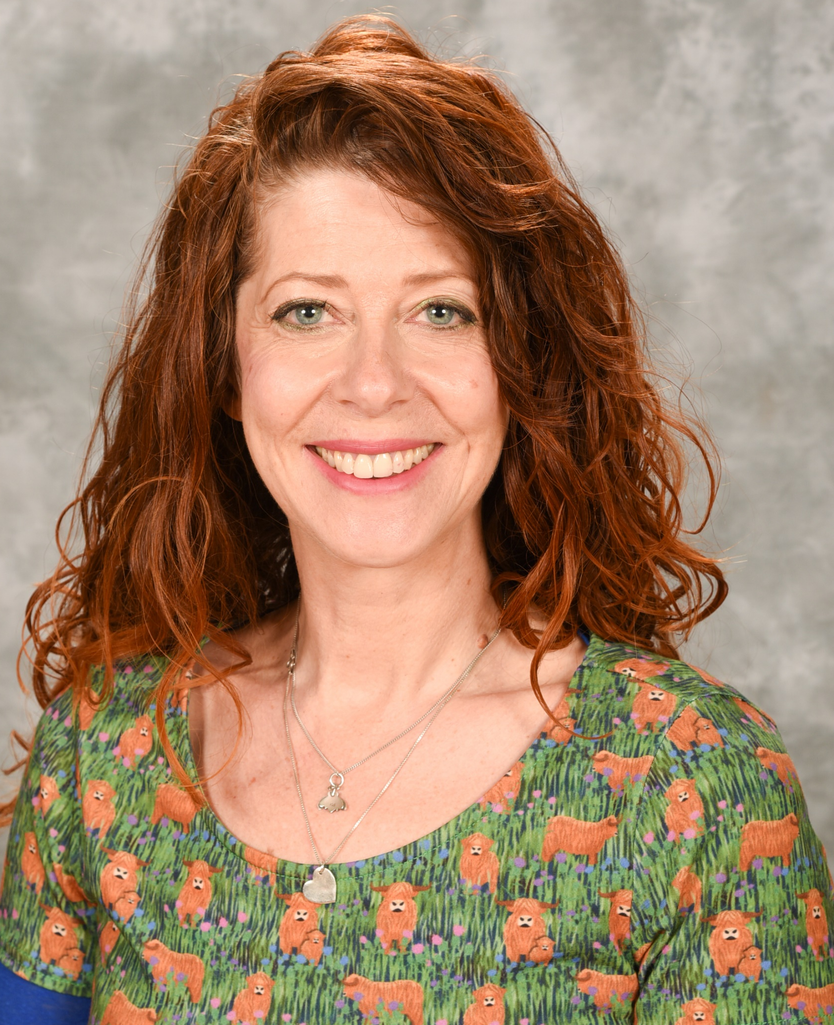
Meet Our Team!
Miss Pope
Pastoral Support
Mrs McCarthy
Thrive Practitioner
Mrs Dexter
SEN Support
Mrs McDavid
ELSA
Mrs Reeves
SENDCo
Inclusion Lead
Senior Mental Health Lead
Mrs Lucas
Thrive Practitioner

Slide 3
community
pride
teamwork
support
inclusive
diverse
intervention
groups
Burton Primary School has high aspirations for all pupils identified as having SEND in our school. We strive to ensure that all pupils achieve their best, that they become confident individuals living fulfilling lives, and make a successful transition into adulthood, whether into employment, further or higher education or training.
values
listening
inspiring
sensory
scaffolding
active
relationships
Life-skills
nurture
differentiation
friendship
High quality teaching
engagement

Slide 4
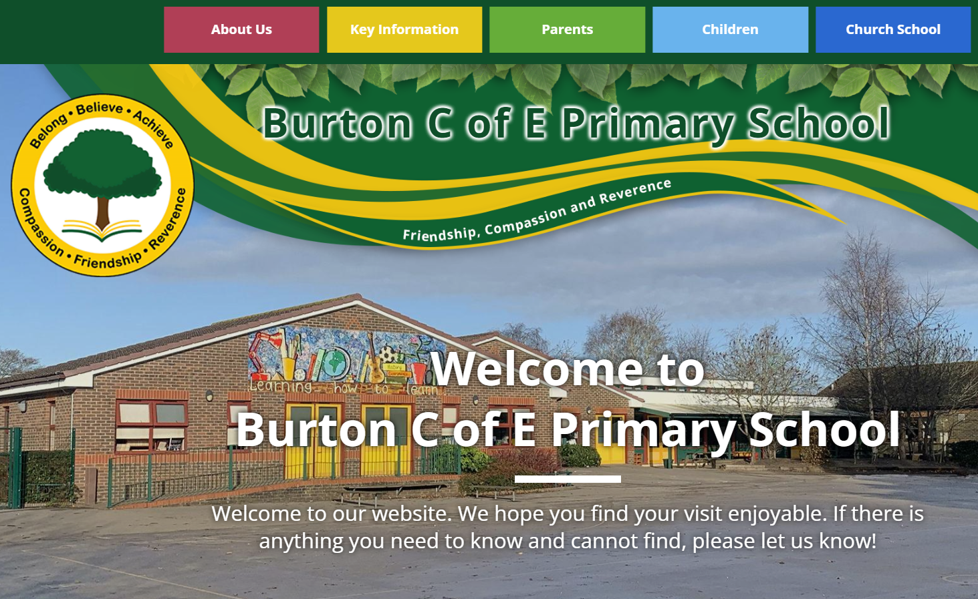
https://www.burtonschool.co.uk/

Slide 5



Miss Pope
Pastoral Support
Mrs McDavid
ELSA

Slide 6


How does Thrive work?
Thrive offers a trauma-informed approach to improving the mental health and wellbeing of children and young people, boosting young people’s self-awareness and resilience every day.

Slide 7
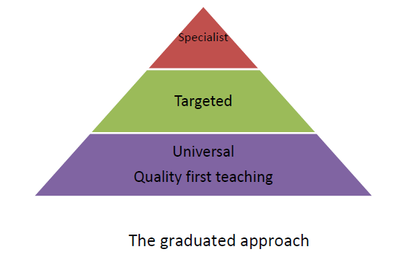

Slide 8
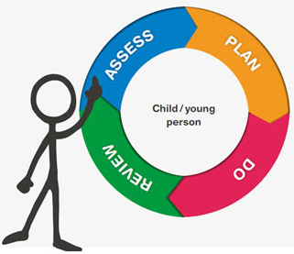
The Graduated Response in school
Assess
Gather background information on the child to give a holistic picture as well as a clear analysis of their needs.
parental concerns
involvement from other professionals
preferred learning styles
observations, tracking or assessment
Plan
Identify key outcomes in response to identified needs – Learning Plans.
focus on small step targets (with parents and child involvement)
recommendations from others involved
environment and routines and any possible sensory factors

Slide 9
Do
Implement a Learning Plan (alongside Quality First Teaching) so that:
all staff to know the targets and outcomes the child is working towards
whole team approach - all staff to be familiar with the interventions, strategies and provision
record progress throughout, making notes to aid review
Review
Review the targets and provision in place, think about:
Has the child been able to achieve the targets/outcomes identified?
Have the targets been appropriate?
Has the family been able to engage at home?
Does the rate of progress still raise concern?
Has provision been effective?
Are there changes needed? How are these going to be achieved?
Revisit any assessment tools regularly to inform reviews

Slide 10

Every Wednesday in the Dolphin Room 1:45-3:15pm
Please come along to chat to other parents and our inclusion team, have valuable training and advice from outside professionals – all whilst enjoying tea and biscuits!
Wednesday 16th October | Meet the Team! | Meet and chat to our School Inclusion Team
Wednesday 23rd October | Information Share | Emotion Coaching led by Gill Oldfield (SEMH Outreach Teacher)
Wednesday 6th November | Chill and Chat | A relaxed opportunity to come and have a chat and a cup of tea with other parents
Wednesday 13th November | Information Share | Speech, Language and Communication led by Alice Blackburn (Speech Therapist)
Wednesday 20th November | Chill and Chat | A relaxed opportunity to come and have a chat and a cup of tea with other parents
Wednesday 27th November | Chill and Chat | A relaxed opportunity to come and have a chat and a cup of tea with other parents
Please register your interest for each session office@burtonpri.dorset.sch.uk

Slide 11

questions
feedback
What would you like?

