Slide 1

Understanding Education, Health, and Care Plans (EHCPs)
A Guide for Parents
An Education, Health, and Care Plan (EHCP) is a legal document that outlines the support a child with special educational needs (SEN) or disabilities should receive. It can be a helpful tool in primary school but also has its challenges.

Slide 2
What is the definition of Special Educational Needs and Disabilities (SEND)
A child or young person has SEN if they have a learning difficulty or disability which calls for special educational provision to be made for him or her. ​
A significantly greater difficulty in learning than the majority of others of the same age, or​
A disability which prevents or hinders him or her from making use of facilities of a kind generally provided for others of the same age in mainstream schools or mainstream post-16 institutions​
Special educational provision is educational or training provision that is additional to, or different from, that made generally for other children or young people of the same age by mainstream schools​
C&F ACT 2014 Chapter 6 PART 3 - 21 PART 3 20 (1) (2) (3)
SEND Code of Practice, January 2015

Slide 3
The definition of Special Educational Provision is…..
Educational or training provision that is additional to or different from that made generally for others of the same age.
This means provision that goes beyond the differentiated approaches and learning arrangements normally provided as part of quality first teaching, (QTS) within the setting or require the involvement of specialist staff or support services.
As part of using its ‘best endeavours**’, an education setting should have arrangements in place to identify the need for and secure such provision, whether through expertise and resources available within the setting or by drawing on support from outside services.
*C&F ACT 2014 Chapter 6 PART 3 - 21 Children and Young People in England with Special Educational Needs or Disabilities 20
** Chapter 6 section 66 (297 & 298)

Slide 4
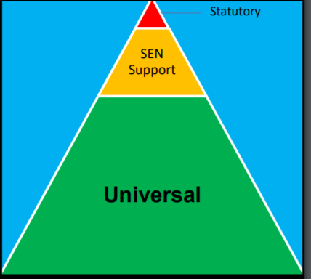
The Graduated Response:
Statutory: (EHCP) Only a small percentage of children with SEND will require the support of an Education Health and Care Plan. When a child’s needs are complex, severe and long term and an education provider cannot meet their needs from within their own resources, and they have exhausted all SEN support options, a statutory assessment of the child’s needs will be undertaken.
SEND Support: (Universal Plus) Where quality first teaching approaches have not been sufficient to meet the child’s needs and they now require more focused, targeted support, they will be identified as having SEND: ‘A pupil has SEN where their learning difficulty or disability calls for special educational provision, that is provision different from or additional to that normally available to pupils of the same age.’ Quality first teaching, including evidenced, robust use of the assess, plan, do, review cycle, rigorous early years practitioner/teacher oversight, and close liaison between the setting and family will continue.
Quality First Teaching: (Universal) Quality First Teaching and the use of personalised, differentiated approaches form the universal offer for all children and young people in educational settings. This will include the robust use of the ‘assess, plan, do, review cycle’, rigorous early years practitioner/teacher oversight, and close liaison between the setting and family

Slide 5
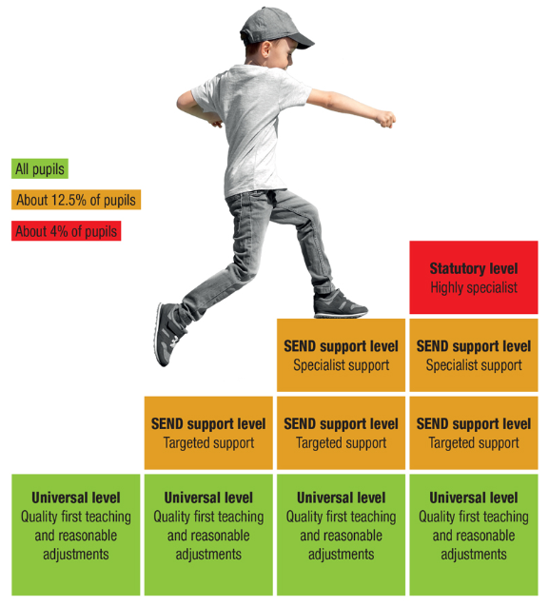

What levels of support are there? (bcpcouncil.gov.uk)

Slide 6
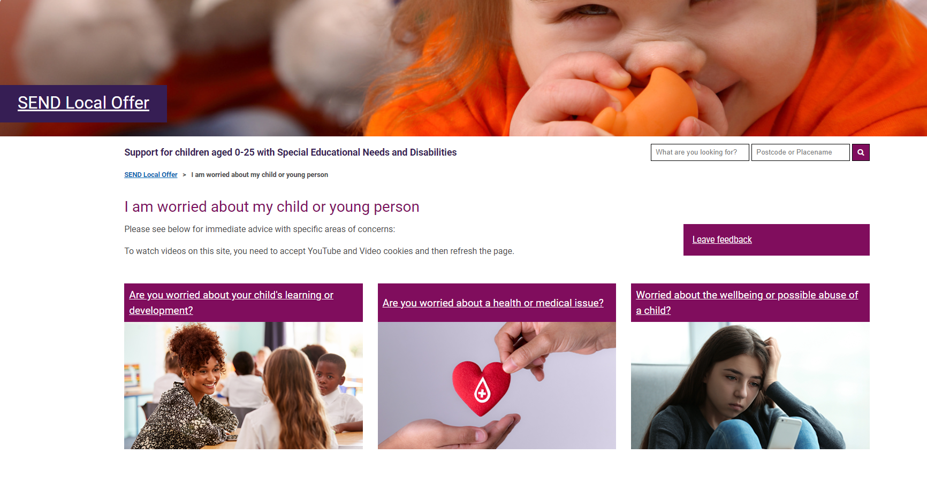
I am worried about my child or young person (bcpcouncil.gov.uk)
What to do if you are worried about your child's learning WEB (bcpcouncil.gov.uk)

Slide 7



Slide 8
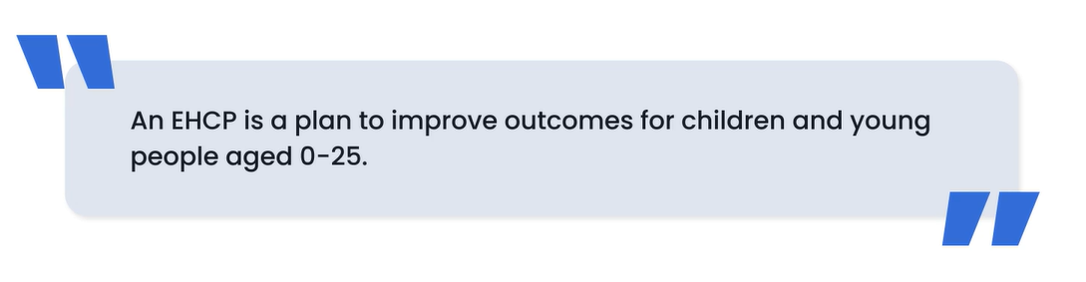
What is an EHCP?
  An Education, Health, and Care Plan (EHCP) is a legal document that outlines the support a child or young person (up to 25) with special educational needs (SEN) or disabilities needs in education, health, and care.
  It brings together education, health, and social care services to support the child.
  The EHCP is reviewed annually to ensure it continues to meet the child’s needs.

Slide 9

EHCPs were first introduced in 2014 as part of the Children and Families Act SEND reforms.
To bring together education, health and care using a holistic approach to support a child’s needs.

Slide 10

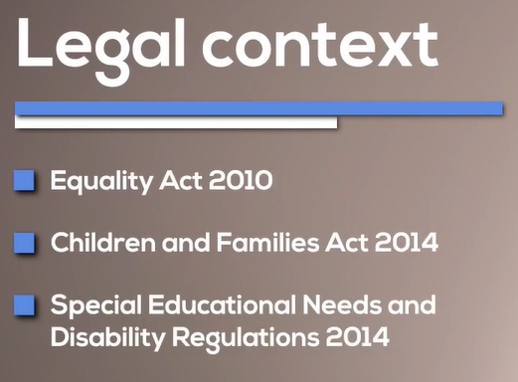
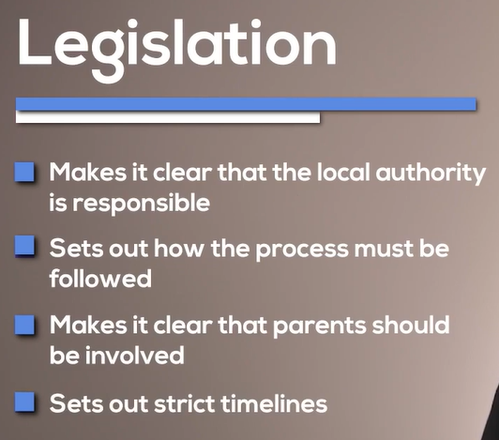

Slide 11
To be considered for an EHCPN assessment, the child’s needs cannot be met under universal provision and they will need to have long-term additional support to access learning. This may also include children that will need specialist provision.
Who is Eligible for an EHCP?
  Children or young people with significant learning difficulties or disabilities that cannot be met by the local mainstream school’s support alone.
  The child must be under 25 years old.
  The needs should require special provision, which can’t be provided through the standard curriculum or resources.

Slide 12
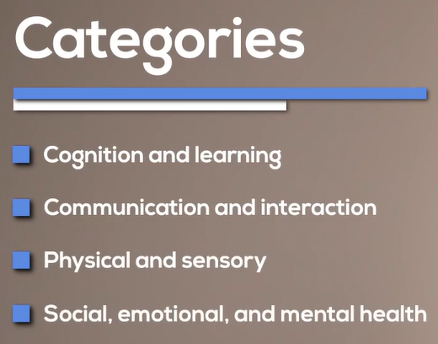


Slide 13

Benefits of an EHCP
Why is an EHCP Important?
  Personalised Support: Tailored support ensures the child's needs are met.
  Legal Entitlement: EHCPs are a legal right, and schools must provide the specified support.
  Holistic Approach: It takes into account the child’s education, health, and care needs.
  Clear Path Forward: The plan outlines specific goals and how to achieve them.

Slide 14
The Components of an EHCP
What Does an EHCP Include?
  The child’s needs: Describes the child’s specific needs.
  Support required: Outlines what support is needed (e.g., extra help in school).
  Goals and outcomes: Specifies what the child should be working towards.
  Health and social care support: Includes any required health or care services.
  Provision in education: Describes the school or setting best suited to the child's needs.

Slide 15
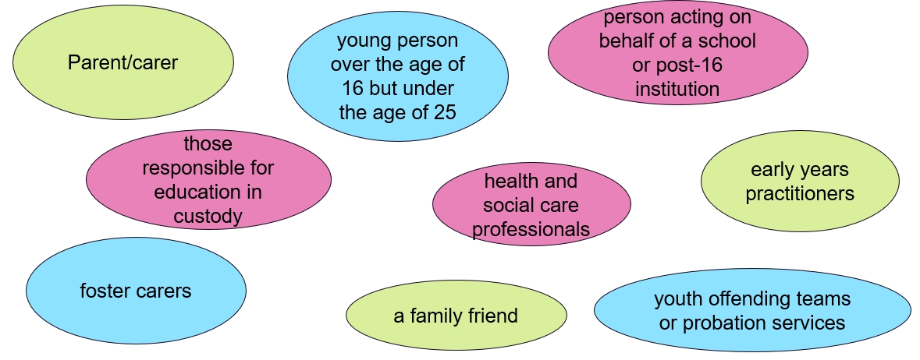
Who can request an EHC Needs Assessment (EHCNA)?

Slide 16

What is an Education, Health and Care Needs Assessment (EHCNA)?

Slide 17
Considering evidence as part of a new EHC request
SEN and Disability Code of Practice 2015 (the Code), paragraph 9.14 states, BCP will need to take into account a wide range of evidence, and should pay particular attention to:
Attainment and rate of progress or developmental milestones
Information about the nature, extent and context of the child or young person’s SEND
Evidence of the action and reflection (Assess, Plan, Do, Review cycle)
Evidence that where progress has been made, it has only been as the result of much additional intervention and support over and above that which is usually provided
Evidence of the child or young person’s physical, emotional and social development and health needs, drawing on relevant evidence from clinicians and other health professionals and what has been done to meet these by other agencies,
Where a young person is aged over 18, the LA must consider whether the young person requires additional time to complete their education or training.

Slide 18

The EHCP Process
Requesting an EHCP Assessment: A parent, carer, or professional can request an assessment.
Needs Assessment: The local authority gathers information from professionals (e.g., teachers, doctors).
Panel: A panel of specialists decide upon the outcome of the needs assessment.
EHCP Draft: The local authority drafts the EHCP with input from parents and professionals.
Final EHCP: The local authority issues a final plan.
Review: The EHCP is reviewed annually to ensure it’s still relevant.

Slide 19
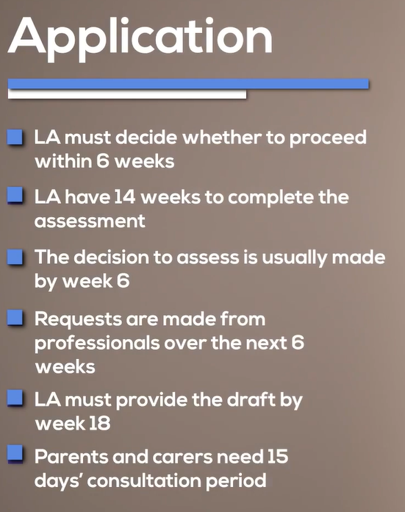
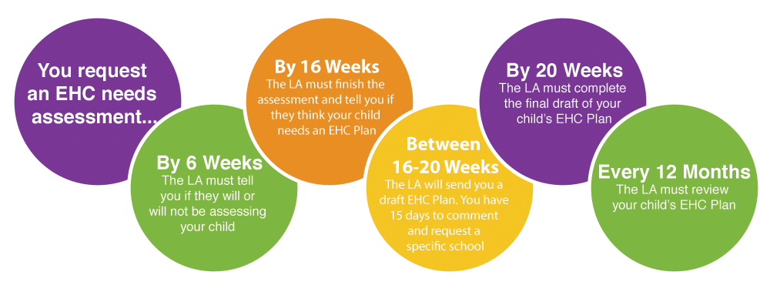

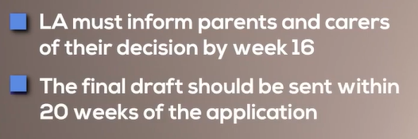
Key Timelines in the EHCP Process
Key Timelines
  Assessment: The local authority must decide within 6 weeks whether an assessment is needed.
  Draft EHCP: If approved, the draft EHCP must be issued within 14 weeks.
  Final EHCP: After the draft, the final EHCP should be issued within 20 weeks.

Slide 20
Whose Evidence is Required if an Assessment is agreed?
SEN Reg 6(1) and the Code of Practice (9.46) The LA must seek advice on needs, outcomes and provision from
Child’s parents or the young person
Head teacher or principal of school/post-16 settings that they are attending
Medical advice and information from a health care professional
Educational psychologist
Advice and Information in relation to social care
Advice and Information from any other person LA thinks appropriate
Advice and information in relation to prep for adulthood and independent living (for pupils in or beyond Yr. 9)
Any person child’s parent or young person reasonably requests

Slide 21

Common Questions About EHCPs
FAQs About EHCPs
  Can an EHCP be changed? Yes, it is reviewed annually and can be updated.
  Is an EHCP only for children with severe disabilities? No, it's for any child who needs significantly more support than what a mainstream school can provide.
  Can I appeal if I'm not happy with the plan? Yes, there’s an appeals process through the SEND Tribunal.

Slide 22

Supporting Your Child Through the EHCP Process
Supporting Your Child
  Stay informed: Keep track of key dates and deadlines.
  Communicate with the school: you are all working towards the same goal for the child.
  Stay involved in reviews: Attend annual reviews and discuss any changes needed.
The Annual Review process

Slide 23

Further Information and Resources
  Local Authority Support: Contact the local authority’s SEND department for guidance.
  SENDIASS: Special Educational Needs and Disability Information Advice and Support Services.
  Parent Carer Forums: Local groups for parents of children with SEND.
  Websites for more details: e.g., SEND Code of Practice, GOV.UK SEND resources.

Slide 24
Pros of an EHCP in Primary School:
Individualised Support:
  An EHCP ensures that the child receives tailored support specific to their needs, whether that's in terms of learning, behaviour, or health care.
Legal Protection:
  It is a legal document, meaning the child has a right to the support and services outlined in the plan. Schools are required to follow the plan, providing a level of security for the child and parents.
Coordinated Support:
  An EHCP brings together services from education, health, and social care, creating a more holistic approach to supporting the child, especially if they need therapy, medical care, or other interventions.
Access to Specialized Resources:
  Children with EHCPs may gain access to specialized teachers, learning support assistants, or equipment, which can be crucial for their development.
Continuity as They Grow:
  The plan evolves with the child, ensuring that as they progress through school, their support needs are reassessed and updated, providing continuity of care and education.
Parental Involvement:
  Parents are involved in the process of creating and reviewing the EHCP, giving them a stronger voice in decisions about their child’s education.

Slide 25
Cons of an EHCP in Primary School:
Lengthy and Complex Process:
  The process of getting an EHCP can be long, sometimes taking several months or even longer. It requires assessments from professionals, and paperwork can be overwhelming for parents and schools.
Stigma or Labelling:
  Some children might feel different or stigmatized if they have an EHCP, especially if their peers or others don't fully understand its purpose. This could affect their self-esteem.
Inflexibility:
  An EHCP is based on a child’s needs at a specific point in time, which can be limiting if the child’s needs change quickly or unexpectedly. This can sometimes make it hard to adapt to new challenges or circumstances.
Resource Strain on Schools:
  Implementing the support outlined in the EHCP can sometimes put additional pressure on the school’s resources. Not all schools are equally equipped to provide the specialised services that an EHCP might require.
Conflict or Disagreement:
  There can be disagreements between parents, schools, and local authorities about what the child needs or how much support they should receive. The process to resolve these conflicts can be time-consuming and stressful.
Not Always Enough Support:
  Even with an EHCP, there may still be limitations in the type or level of support a child receives, especially if there are budget constraints or resource shortages in the local area.

Slide 26


