Slide 1


Anxiety in school aged children
9:00-9:15 – Tea/coffee and welcome (including general housekeeping)
9:15-10:05 – Understanding anxiety – what it is, what causes it and what does it look like?
10:05-10:15 – Tea/coffee (and cakes)
10:15-10:45 – Types of anxiety - thought traps, resources, further support
10:45-11:00 – Workshop evaluation

Slide 2
Objectives
To gain a good understanding of the physiology of anxiety
To be aware of strategies that you can use with your child
To feel more confident in supporting your child with anxiety
To spend time with others in a similar position

Slide 3
Childhood Mental Health Statistics
Young Minds – Prioritising well being in schools
5 pupils in every classroom of 30 suffer from a diagnosable mental health condition.
90% of school leaders have reported an increase in the number of students experiencing anxiety or stress over the last five years
Referrals to specialist mental health services like CAHMS has risen by 53% since 2019
Only one in three children with a diagnosable mental health problem gets access to the treatment and care that they need
81% of young people said that they would like their school or college to teach them more about how to look after their mental health.
50% of mental health problems are established by the age of 14 (Hagell 2015)

Slide 4
Is it normal….?
All children, of all ages, experience powerful emotions
Not all children’s emotions are logical
Many parents are unsure whether their child’s behaviour is something to worry about or whether it is typical behaviour
When thinking about your child’s behaviour, it is important to consider their personality as well as what is happening in their immediate environment
When anxiety is persistent and/or stops your child doing ordinary activities and impacts on their ability to function and develop, there is a cause for concern

Slide 5
Anxiety – What is it? What causes it?
Natural built-in stress response – ‘Fight or flight’
Can be triggered by real or imaginary threats
Anxiety is due to how we perceive situations
Some peoples response is too sensitive, so it is triggered by events that others are able to ignore
Genetics – multiple genes that contribute to anxiety
Learning Model – children learn how to act and react based on ‘models’ in their world
Environmental – e.g a specific event or a specific transition
But, a certain amount of anxiety is NORMAL!
There are expected fears/anxieties associated with each stage of child development

Slide 6
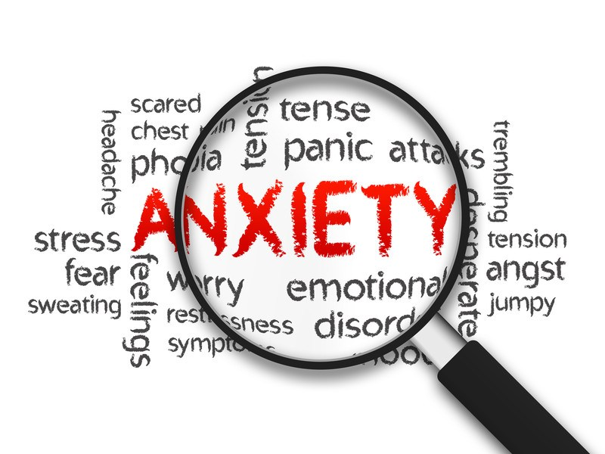
Anxiety
Anxiety – the name given to a group of three feelings:
Worry
Nervousness
Fear

Slide 7
Anxiety – what does it look like?
Physical
Shaking, feeling sick, stomach aches, feeling dizzy or faint, breathing fast, heart beating rapidly, seating, muscles tense, difficulty sleeping or eating, tearful, needing the toilet, jelly legs, headaches
Behavioural
Avoidance of situations/people/events/places, difficulty concentrating and making decisions, clinging to parents, seeking reassurance, escaping situations, not speaking, checking, washing, using comforter, staying inside
Emotional
Angry outbursts, feeling panicky, embarrassed or ashamed, little confidence, lonely, unwell, sad, different, overly responsible
Cognitive
Preoccupation, negative thoughts, thinking bad things are going to happen, thought traps…..

Slide 8
Example
Beth and Chloe are best friends and both love to dance. They ask their mums to take them to a dance class to see what its like. Beth and Chloe go along to a class and watch as the children dance and have fun.
On the way home, Beth says she cant wait for the class next week. Chloe says nothing. All week Beth is excited and talks about nothing but the dance class. She talked about meeting the other children and learning to dance as well as they could. Observing the dance class had a different effect on Chloe. She kept thinking she would never be able to dance as well as the children she saw, that she would make a fool of herself in the class. She struggled to sleep at night but didn’t talk about it to anyone. She was concerned her mum would be disappointed in her if she didn’t go to the class and that Beth would no longer want to be her friend.
On arriving at the dance class, Beth runs in and starts talking to the other children. Chloe stops at the door and bursts into tears.
What caused Chloe to be anxious but Beth not?

Slide 9
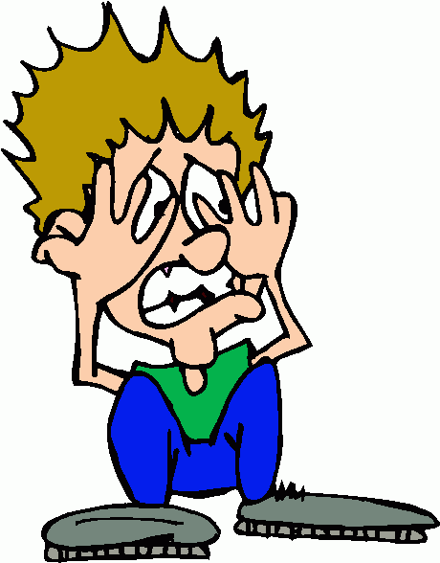
Types of anxiety
Separation anxiety
Generalised Anxiety Disorder (GAD)
Specific phobias
Obsessive Compulsive Disorder (OCD)
Social Anxiety
Post Traumatic Stress Disorder (PTSD)
Panic Disorder

Slide 10
Thought Traps – Thinking Glasses
Magnifying glasses – everything seems bigger, worse, more important or dangerous than it actually is
Make-believe glasses – you imagine things to be true even though you don’t know whether they are or not
Mind reading glasses – you imagine what other people are thinking even though you don’t know if its true or not
Fortune –telling glasses – you predict bad things will happen in the future
Doom and gloom glasses – you see the worst in everything around you and think everything is wrong or will go wrong
What if? Glasses – you think ‘what if this bad thing happens?’ even though it may be unlikely to happen
‘I’m useless’ glasses – you put yourself down
‘I should’ glasses – you think you should be perfect at things and not make mistakes. Also, you may think that if you aren’t perfect at things, bad things will happen or you wont be loved.
‘I can’t’ glasses – you think you cant do things even though you can – or at least you can try

Slide 11
Cognitive Behavioural Therapy (CBT)
Thoughts
Feelings
Behaviour

Slide 12
CBT based techniques
Understanding the physiology of anxiety (psychoeducation - worksheets)
Understanding the triggers for your child’s anxiety
Thought diary (be a thought detective! Search for the facts - worksheets)
Planning small steps towards a goal (ladder technique - worksheet)
Behavioural experiments (be a behavioural scientist! - worksheets)

Slide 13
What else can help?
Think about your own anxieties – what are they? How do you cope? How do your children see you manage? Do you rely on reassurance from your child?
Understand the child’s anxiety – what, when, where, how…
The goal isn‘t to eliminate anxiety, but to help a child manage it
Don‘t avoid things because they make the child anxious
Don‘t take over and do things for them
Don‘t promise fears are unrealistic, show confidence you know they will manage
Respect their feelings but don‘t empower them
Don‘t ask leading questions
Try to keep the anticipation short

Slide 14
What else can help?…..
Talk it through – what might happen if…? What would you do? How would you cope? Make a plan
Build the child's personal strength – praise, ask them to do things you know they are good at
Try to bring perspective to worries, eg re-label them according to who needs to worry about them
Designate 'worry time’ each day
Use a ‘worry box’ or a ‘worry eater’
‘I believe in me!’ book
Use a scale (1-10) to measure how anxious they are at different times, notice how it gets better or worse
Relaxation techniques – Mindfulness, breathing techniques
Good diet, good sleep
Try to model healthy ways of managing anxiety

Slide 15
Further help
MindEd – elearning modules for professionals and/or families. The modules cover a range of topics inc. tics, autism, avoiding school, the worried child, the aggressive child, sleeping difficulties……..
Steps to Well-being – counselling service via GP or self referral
Charities – Young Minds, MIND, Beat, Restored, Family lives, MOSAIC
Books – ‘Overcoming your child’s fears and worries’ by Cathy Creswell and Lucy Willetts.
‘Starving the anxiety gremlin’ by Kate Collins-Donnelly.

